Slide 1
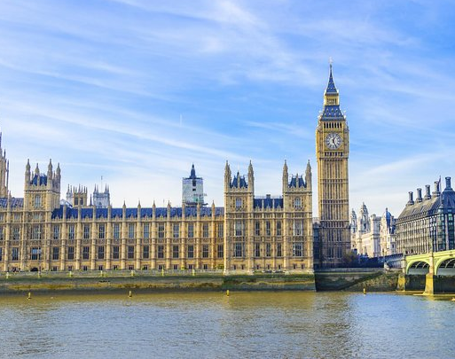
Westminster Shorter Catechism
Questions 34 - 35
April 18, 2021
Calvary OPC, La Mirada, CA

Slide 2
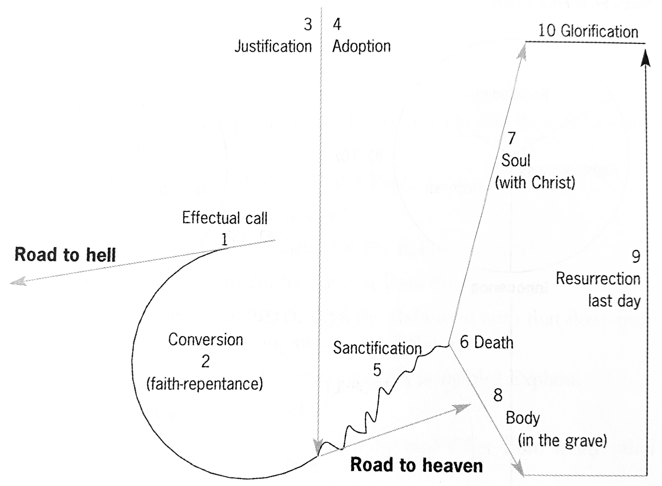

Slide 3
Continuing the ordo salutis
Faith & Repentance (F)
Justification (J)
Sanctification (S)
Glorification (G)
Regeneration (R)
Adoption (A)
Election (E)
Calling (E)
Historia salutis: the history of salvation; ordo salutis: salvation applied

Slide 4
Graces, Acts and Works of God
Regeneration Grace
Faith and repentance Grace
Justification Act
Adoption Act
Sanctification Work

Slide 5
Question #34
Q. What is adoption?
A. Adoption is an act of God's free grace, whereby we are received into the number, and have a right to all the privileges of the sons of God.

Slide 6
What does the Bible say?
"Behold what manner of love the Father has bestowed on us, that we should be called children of God!" (1John 3:1)
"But as many as received Him, to them He gave the right to become children of God, to those who believe in His name:" (John 1:12)
"and if children, then heirs—heirs of God and joint heirs with Christ, if indeed we suffer with Him, that we may also be glorified together." (Romans 8:17)

Slide 7
In the ordo salutis
Adoption follows justification, not necessarily in temporal order, but in logical order
An understudied area of the catechism
It is a one-time judicial act
just like justification (following it)
not a work

Slide 8
The universal brotherhood of man?
This is a modernist, universalist teaching
There is a kernel of truth to it
We are all created from one blood (Acts 17:26)
God is also the Father of all spirits (Hebrews 12:9)
God has care for every man (Luke 10:29)
But in an unregenerate state man is a child of the devil (John 8:44)!!
Thus, to be a child of God needs something extra
Q: what?

Slide 9
To know someone personally
We are adopted into God's family, because God knew us each individually and personally before time began!
Q: How does God know us or just knows about us?
yada, kennen-erkennen, tudni-ismerni
"Before I formed you in the womb I knew you; Before you were born I sanctified you; I ordained you a prophet to the nations." (Jeremiah 1:5)
God knows Jeremiah personally, because He elected him, and gave him a task to fulfill

Slide 10
Matthew 7:21-23
"Not everyone who says to Me, ‘Lord, Lord,’ shall enter the kingdom of heaven, but he who does the will of My Father in heaven. Many will say to Me in that day, ‘Lord, Lord, have we not prophesied in Your name, cast out demons in Your name, and done many wonders in Your name?’ And then I will declare to them, ‘I never knew you; depart from Me, you who practice lawlessness!’"
It is not enough to do good deeds, we must be in a living relationship with God whereby we do things out of love and gratitude

Slide 11
Galatians 4:4-7
"God sent forth His Son, born of a woman, born under the law, to redeem those who were under the law, that we might receive the adoption as sons. And because you are sons, God has sent forth the Spirit of His Son into your hearts, crying out, “Abba, Father!” Therefore you are no longer a slave but a son, and if a son, then an heir of God through Christ."
We are in a true, living, personal relationship with God
God the Father looks upon as His own sons and daughters!

Slide 12
The benefits of being a child of God
Q: What benefits do you have as a child of God? List them!
Assurance of God's love
peace of conscience
joy in the Holy Spirit
increase of grace
perseverance to the end
God's Word
God's revealing His will
protection from God's enemies
daily bread and clothes
fellowship with the brethren
eternal salvation
come boldly to the throne of grace in prayer (Heb 4:16)

Slide 13
Question #35
Q. What is sanctification?
A. Sanctification is the work of God's free grace, whereby we are renewed in the whole man after the image of God, and are enabled more and more to die unto sin, and live unto righteousness.

Slide 14
What does the Bible say?
"But we are bound to give thanks to God always for you, brethren beloved by the Lord, because God from the beginning chose you for salvation through sanctification by the Spirit and belief in the truth, " (2Thess. 2:13)
"and be renewed in the spirit of your mind, and that you put on the new man which was created according to God, in true righteousness and holiness." (Ephesians 4:23-24)

Slide 15
What does the Bible say?
"that just as Christ was raised from the dead by the glory of the Father, even so we also should walk in newness of life. For if we have been united together in the likeness of His death, certainly we also shall be in the likeness of His resurrection, knowing this, that our old man was crucified with Him, that the body of sin might be done away with, that we should no longer be slaves of sin." (Romans 6:4,6)
Therefore, my beloved, as you have always obeyed, not as in my presence only, but now much more in my absence, work out your own salvation with fear and trembling; for it is God who works in you both to will and to do for His good pleasure. (Phil. 2:12-13)

Slide 16
Models of sanctification according to the ordo salutis
Roman Catholicism:
You earn justification for your sanctified good works (plus some grace)
J + S => G
No assurance of salvation
This is the sin of presumption
Biblical (Evangelical, Calvinist)
You can never be justified by your own works
You must do good by default (Luke 17:10)
You are justified and covered by the righteousness of Christ
J => S => G
Q: why do you do good?

Slide 17
Philippians 2:12-13
"Therefore, my beloved, as you have always obeyed, not as in my presence only, but now much more in my absence, work out your own salvation with fear and trembling; for it is God who works in you both to will and to do for His good pleasure."
Sanctification is synergistic
100% + 100% = 100%
You don't sanctify yourself by your own power!
Like the Trinity or election, it is another mystery

Slide 18
Sanctification and assurance
Faith without works is dead (James 2:24)
Sin is still indwelling but not overpowering
Sanctification is a gradual work, and engenders constant reliance on the Holy Spirit
if we say we have no sin, we are liars (1John 1:8)
We reject Pentecostal perfectionism
Look not at your works, nor at your faith, but at Christ alone
The righteous man may fall seven times a day (Proverbs 24:16), but you must always, always turn to God in repentance appealing the blood of Christ

Slide 19
Sanctification and works
We are saved by faith alone, but our faith does not stand alone, we must have good works
Sanctification begins with an inward change when we are regenerated
Justification is the grounds for sanctification: they are tied to one another but are not the same thing

Slide 20
Sanctification and works, part 2
Before we knew Christ, the law was our enemy, after repentance it is our guide and our friend
"How I love your law"
Sin grieves the believer
Q: What was the proof that King David truly repented of his affair with Bathsheba? [1Kings 1:1-5]
We die more unto sin and live more unto righteousness
Q: What kinds of sins have you left behind as part of your sanctification?
Since we are saved, how shall we then live?
Ethics
Biblical counseling

Slide 21
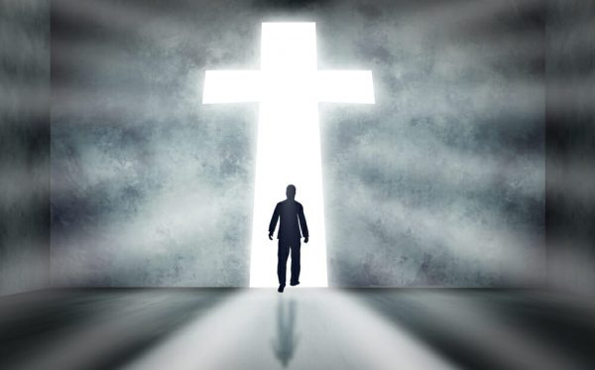

Slide 22
Weekly Bible verse
For a righteous man may fall seven times and rise again, but the wicked shall fall by calamity.
(Proverbs 24:16)

